Slide 1
understanding the node.js event model
M. SRIVARSHINI
22H51A05A6
CSE-D

Slide 2
INTRODUCTION
What is Node.js:
Node.js is a tool that lets you run JavaScript (a programming language usually used in web browsers) on servers.
It’s built on Chrome's V8 engine, which is a fast and efficient engine for running JavaScript.
Think of Node.js as a way to use JavaScript not just for making websites interactive, but also for handling tasks on the server side, like managing databases, handling files, or communicating with other servers.

Slide 3
Importance of the Event Model
Node.js uses an event-driven architecture, which is different from the way traditional servers work.
In traditional models, when a request comes in, the server might have to wait (or block) while it completes a task before moving on to the next one.
In Node.js, instead of waiting, the server can continue to work on other tasks. When an event (like a file being read) is finished, it triggers a response. This allows Node.js to handle many tasks at once, making it efficient and fast for handling multiple users at the same time.

Slide 4
Understanding Event-Driven Programming
Event-driven programming is a way of writing programs where actions are triggered by events.
An event can be anything, like a user clicking a button, a message arriving from another program, or a file finishing loading.
Instead of writing code that runs in a strict, step-by-step order, you write code that waits for specific events and then responds to them.
For example, in a chat application, you might write code that waits for a user to send a message and then processes that message when the event occurs.

Slide 5
How the Node.js Event Model Works
Single-Threaded Nature
Node.js is single-threaded, which means it uses just one main thread to run your JavaScript code.
In most programming environments, multiple threads are used to handle different tasks simultaneously, but Node.js does it differently.
Even though it has only one thread, Node.js can handle many tasks at once, thanks to its event loop.
The event loop allows Node.js to keep working on other tasks while waiting for certain operations (like reading a file or making a network request) to finish. This makes Node.js very efficient, especially for tasks that involve a lot of waiting or interacting with external resources.

Slide 6
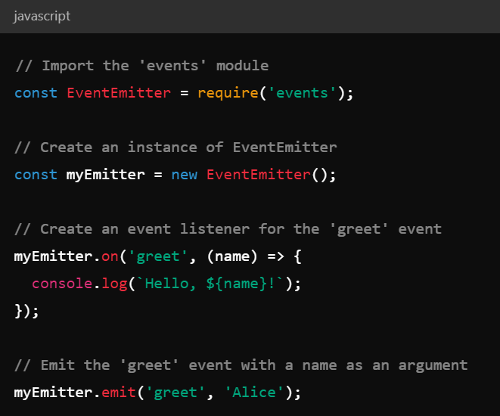
Emitting and Handling Events

Slide 7
Advantages and Conclusion
Non-blocking I/O
Handling Many Connections Efficiently
Scalability
Large Collection of Tools
Conclusion:
Node.js’s event model is powerful for handling multiple tasks efficiently without blocking, but it requires careful management of asynchronous code to avoid complexity. Mastering this model is key to building fast and scalable applications.

Slide 8
THANK YOU

